Slide 1
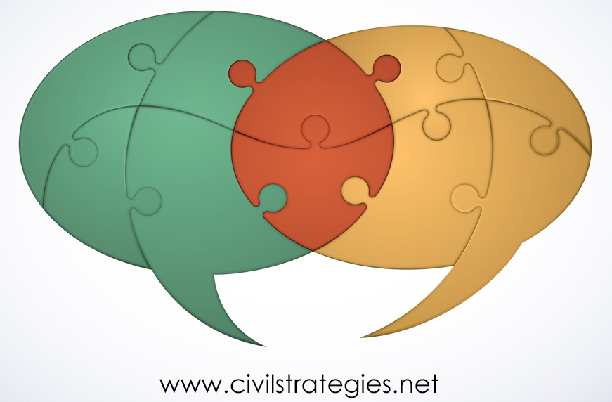
A Culturally Responsive
Design, Monitoring & Evaluation Approach
for Widening Participatory Dialogue &
Improving Public Engagement & Program Impact
© 2020 Deborah L. Trent, Ph.D.
NASPAA Conference, October 2020
Notes:
(Greetings)
Thanks to the Network of Schools of Public Policy, Affairs, and Administration for the opportunity to present this research and its implications for teaching and practicing. I’ve worked in the U.S. government and at partnering nonprofits on public and citizen diplomacy program design, management, and evaluation. I have been consulting and training on global educational and cultural programs for two decades.

Slide 2
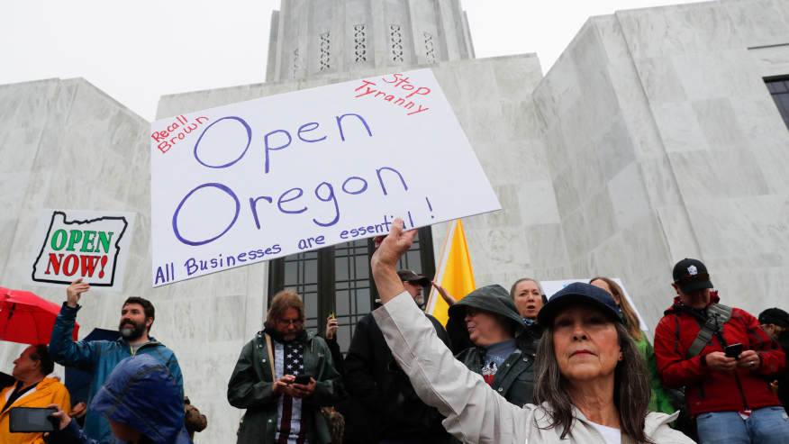
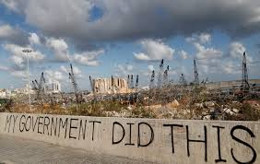
Notes:
Governors continuing shutdowns based on novel coronavirus incidence data interpreted by public health officials are being blocked by court rulings as well impatience if not protest by individuals, business owners, and organized groups across the U.S., according to the WaPo piece, Courts signal frustrations over continued restrictions" (Anne Gearan and Karin Brulliard, 9/17/20, https://thewashingtonpost.pressreader.com/@trent_deborah/csb_7__vWx30rFCexmNWjgY6tGEjcv_3h0eYrrZxlVShXZ8vUiX2tQWnNOQtmIGTxdeHrpkYn4X-rXe2vhJYuz6OIg). The August explosions of improperly stored ammonium nitrate at the port of Beirut make the Lebanese people even more defiant about their corrupt government. These are just two scenes of the volatile, uncertain, complex, and ambiguous civic square, where the masked and unmasked, the Zooming activists and social media avatars, and confusingly brief Twitter messages are the standard communication modes.
https://ktla.com/wp-content/uploads/sites/4/2020/05/GettyImages-1211647513.jpg?w=876&h=493&crop=1
https://images.app.goo.gl/HwPX7i9LcTGD7yxb9; https://www.nbcnews.com/news/world/they-have-started-war-anger-despair-beirut-protesters-call-regime-n1236234

Slide 3
CRE: historical, political, relational, and discursive forms of power (Stickl Haugen and Chouinard, 2019) DME: participatory, inclusive communication (Dagron, 2001; Zaharna, 2010; Quick & Feldman, 2011; Waisbord, 2014, 2015; Pamment, 2016; Trent, 2018) + genuine dialogue (Fitzpatrick, 2011; Trent, 2018)
Culturally Responsive Evaluation
Program Design, Monitoring and Evaluation
Culturally Responsive Design, Monitoring and Evaluation
Notes:
Governing democratically means upholding freedom of expression about individual human rights, cultural heritage, social injustice and inequality, and corruption while safeguarding health and preventing violence – all to craft policy and programs that are responsive to people’s grievances. Put another way, it involves mediating power struggles.
MPA, MPP, and doctoral program curricula have long conveyed the value and use of deliberative democratic communication and analytical tools and processes to shape programs that address unequal power and cultural differences. The purpose of this presentation is to argue for more teaching and research on power dynamics and relational-to-transformational public communication and engagement.
“Culturally responsive” evaluation, or CRE, “recognizes that demographic, sociopolitical, and contextual dimensions, locations, perspectives, and characteristics of culture matter fundamentally in evaluation (Hopson, 2009, 431, in Hood, Hopson, Kirkhart, 2015, 283). CRE measures power in four dimensions: the historical and temporal, the political, the relational, and the discursive (Stickl Haugen and Chouinard, 2019 ,378).
The present research integrates CRE with cyclical program design, monitoring, and evaluation, or DM&E (Trent, 2018). CRDM&E provides a framework for administering a diverse, conflictual civic square, with its focus on cultural norms and beliefs, on understanding and balancing power, and on engaging with participatory, inclusive communication and genuine dialogue.

Slide 4
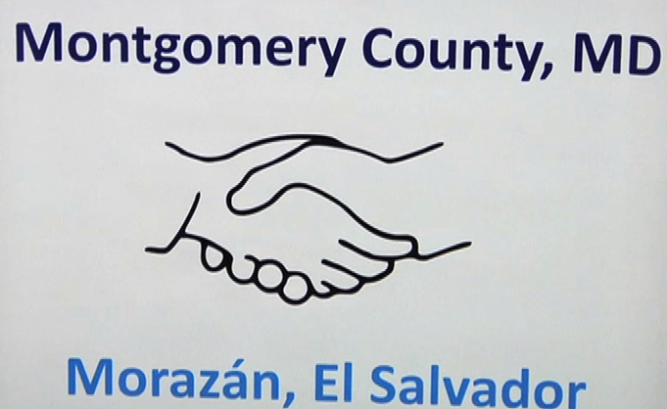
Three Cases
4
Notes:
My 2018 qualitative study of three cross-sector partnerships in public and citizen diplomacy. The International diaspora Engagement Alliance (IdEA) – has been funded by U.S. Department of State and Agency for International Development, and Calvert Impact Capital (formerly Calvert Foundation) was the managing partner from 2013 to 2016. The Chicago-Kyiv Sister City partnership was established in 1991. The sister city agreement between Montgomery County, Maryland, and the El Salvadoran state of Morazán was inked in 2011.
The three meet the selection criteria of cross-sector relationship-building that include: demographically diverse, global publics – i.e., ethnic diasporas; significant contribution of resources from the public, nonprofit and private sectors; glocal public sector stakeholders; and program goals spanning education, culture, health, trade & tourism, good governance and philanthropy.
The three cases feature public engagement with substantial voluntary nongovernmental stakeholder-participants, cultural diversity, space for participants to independently design, monitor, and evaluate their programs according to their interests, skills, and networks, and participant-led mediating of power imbalances in order to carry out their missions of cross-cultural awareness and cooperation.
-------------------
http://www.diasporaalliance.org/
http://www.chicagosistercities.com/events/gala-banquet-for-the-25th-anniversaries-of-ukrainian-independence-and-the-sister-city-anniversary-between-chicago-and-kyiv/
http://s19499.pcdn.co/wp-content/uploads/2012/04/Salvadoran-Delegation-CRTW-Ep.106-04-27-12-e1423764710896.png
--------------------------

Slide 5
Theories of Change
IdEA: Using an events strategy to offer networking and tailored training opportunities along with mentoring and small grant programs, IdEA seeks to increase diaspora integration into diplomacy and development and promote investment, entrepreneurship, philanthropy and volunteerism in heritage countries.
Kyiv: With limited financial support for exchanges, the experienced volunteers aim to foster lasting relationships and collaborative projects across the health care, manufacturing, arts, tourism and government sectors that benefit individuals and tourism, trade, diplomacy and public service delivery in both cities
Morazán: Largely through voluntary community-based organizations, these sister cities strive to increase citizen engagement, events and exchanges dignifying Salvadoran culture, educational opportunity, health care delivery, public/private-sector accountability and living standards.
5
Notes:
Culturally responsive programs account for historical, political, relational, and discursive forms of power and address public problems starts. They start with stakeholder mapping and surveying and aim to develop a theory of change. These three partnerships have emerged from cross-cultural understanding and mutual desire to improve relations through dialogue and joint programs. Letters of agreement, reports, interviews, and stakeholder dialogue reflect broad visions as well as specific goals in each of the three cases. However, in no case was there an explicit theory of change. Instead, in this post hoc, non-experimental impact evaluation, I analyzed narrative patterns and themes in the context of the material results to ground a theory of change for each case.
Since this evaluation lacks random assignment of comparison (control) and treatment groups and pre-program measurement, there is only qualitative validation that the partnerships are responsible for the behavioral change and wider impacts theorized here.

Slide 6
Inclusive stakeholder management
Relationship-Building
Genuine Dialogue
Outputs, Feedback & Adjustments
Confidence-building & Credibility
Outcomes & Impacts
Trust & Collaboration
Participatory Communication
Mediating
and
Evaluating
Engagement,
Power
Dynamics,
and
Programs
through…
…Culturally Responsive Design, Monitoring & Evaluation
6
Notes:
Unpacking the theories of change in these partnerships identifies a cyclical process of mediating and evaluating the public engagement, power dynamics, and programs intended to respond to partnership communication dynamics and program goals. The cycle moves from inclusive stakeholder management through participatory communication and genuine dialogue that build trust, confidence, and consensus among stakeholders and result in credible, and ideally, sustainable, programs. Interviewees described negotiating all four types of power during deliberations within their stakeholder groups -- for example, a bi-cultural sister city committee, and between the U.S. Department of State and a corporate partner. However, given the high level of mutuality and collaboration with which these diplomatic programs started, it is not surprising that little intra- or inter-group conflict was observed. Responding to cultural difference and historical, political, relational, and discursive power dynamics increases in complexity with diversity in stakeholder groups and scale of policy and program.
THESE STEPS – CRDM&E -- ARE THE HOW-THE TRAINING NEEDS TO BE CONVEYED THROUGH IDENTITY- AND DIVERSITY AWARENESS-TRAINING, CASE STUDIES, STRATEGIC ENGAGEMENT AND COLLABORATIVE GOVERNANCE PRAXIS, COMMUNICATION THEORY, CAPSTONE CLIENT PROJECTS, AND LEADERSHIP DEVELOPMENT.

Slide 7
15 Participatory Communication Practices*
Listening Openly
Expressing Voice
Relating as Partners
Forming Multiple Information Channels
Jointly Strategizing, Implementing, Evaluating
Increasing Horizontal Dialogue
Prioritizing Process
Designing Messages Together
Raising Consciousness
Activating Informal/Formal Networks
Contextualizing Policy Problems
Fostering Inclusiveness, Continuity, Diversity
Encouraging Ownership
Deliberating to Understand and Motivate
Experimenting to Transform and Sustain
____________________________________________
*Dagron, 2001; Zaharna, 2010; Quick & Feldman, 2011; Waisbord, 2014, 2015; Pamment, 2016; Trent, 2018
8 Genuine Dialogue Practices*
Mutuality
Presence
Commitment
Authenticity
Trust
Respect
Collaboration
Risk
____________________________________________
Fitzpatrick, 2011; Trent, 2018
Notes:
Trent (2018) measures the quality and impact of public engagement of the three partnerships according to the 15 practices of participatory communication and eight methods of genuine dialogue. Methods include participant observation, interviews, and desk research.
The participatory communication and genuine dialogue practices are qualitative measures in international development, cross-cultural communication, and diplomacy program evaluation. They transfer to other policy and program platforms. Many of these practices are mutually reinforcing, as explained in detail at https://static1.squarespace.com/static/568cd8a0dc5cb4a5b51a8db1/t/5aabfe9b562fa7e1f7c0d883/1521221277165/How+Mutual+Dialogue+and+Participatory+Communication+Work+Together.pdf
For example, “[T]he participatory communication practice of listening openly to absorb multiple perspectives in problem definition, goal-setting, reporting and codifying DM&E processes reinforces the [genuine] dialogic acts of presence” and respect (Trent, 2018). In the three cases, “diplomatists are in close proximity and open to engaging with diverse stakeholders affected by a current or contemplated program before its implementation” (Trent, 2018)..

Slide 8
8 (table continued on next slide)
Notes:
Here and in the next slide, the program foci and material results of the Chicago-Kyiv Sister Cities are displayed. These results were facilitated through the dialogic, participatory communication and relationship-building in the partnership. This sister city is one of Chicago’s most active.
Outputs are completed, discrete activities, for example: cultural events, scholarship fundraising, and exhibition sports.
Outcomes are specific results from outputs, such as expanding educational and cultural opportunities for Ukrainian youth, and strengthening ties between the agricultural and manufacturing sectors
Impacts are the desired goals generated by outcomes, including higher quality mental and physical health care delivery, and greater transparency in government and the private sector.

Slide 9
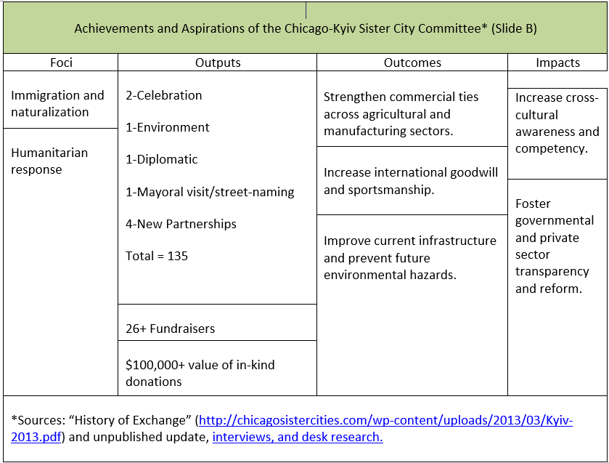
9
Notes:
Part B of the table shows the last two of the seven foci of the Chicago-Kyiv sister cities, along with the remaining output activities, and over 26 fundraising events generating more than $100,000 in donated goods and cash. Three higher-level outcomes and two additional desired impacts complete the partnership’s achievements and anticipated results.

Slide 10
SELECTED FINDINGS: INTERNATIONAL diaspora Engagement Alliance (IdEA)*
Pillars and Goals | Outputs | Outcomes | Impacts
Pillars: Investment & Entrepreneurship Philanthropy Volunteerism Innovation | More than 200 conferences, forums, and events, including 160 during Global Diaspora Week in 2014 and 2015. | Capacity-building across sectors. | Increased diaspora engagement in investment & entrepreneurship, philanthropy, volunteerism, and sustainable development in heritage countries.
Expand diaspora engagement in development and diplomacy | Networking virtually and in person to connect and collaborate. | Promotion of corporate social responsibility among private sector partners. | Strengthened diaspora community-building and capacity to build bridges across generations, cultures, ethnicities, and nationalities.
Build skills and reputation of diaspora organizations as agents of cross-cultural understanding and socioeconomic development | 37 partnerships to design and conduct capacity-building training webinars on organizational strategy, fundraising, management of social media and volunteers, and other topics. | Empowerment of diasporas through training, networking, access to public speaking opportunities. | Larger role for nonprofit and private sectors and P3s for integrating diplomacy and development.
*Sources: http://www.diasporaalliance.org/idea-infographic-2014-2016/, interviews, IdEA Impact Report (August, 2016).
Notes:
Examples from IdEA:
Two major efforts noted in the IdEA Impact Report were promoting diaspora participation in the Latin American Impact Investing Forum in 2014 and 2015 and convening the African Diaspora Investment Symposium in 2014 and 2016 (page 4 of https://static1.squarespace.com/static/568cd8a0dc5cb4a5b51a8db1/t/5ab5809b352f534a0910775b/1521844380444/032318+Outputs%2C+Outcomes%2C+Impacts+of+Three+Diaspora-Engaging+Public-Private+Partnerships.pdf …). IdEA has played a major role, fostering cross-cultural awareness, and new businesses and non-profits. A Calvert Impact Capital manager described the impact as the ‘seeding of a broader entrepreneurial ecosystem and diaspora community-building’ (page 6).
https://static1.squarespace.com/static/568cd8a0dc5cb4a5b51a8db1/t/5ab5809b352f534a0910775b/1521844380444/032318+Outputs%2C+Outcomes%2C+Impacts+of+Three+Diaspora-Engaging+Public-Private+Partnerships.pdf, page 4:
Two other major efforts noted in the IdEA Impact Report were promoting diaspora participation in the Latin American Impact Investing Forum in 2014 and 2015 and convening the African Diaspora Investment Symposium in 2014 and 2016. The former is Latin America’s largest impact investing conference, where IdEA and the U.S.-Mexico Foundation co-hosted an unprecedented gathering to engage diaspora.7 The latter symposium was conceived and initiated by IdEA in 2014 and first held in Washington, D.C., and then in California’s Silicon Valley.8 Collectively – due to IdEA, partners, and lead stakeholders, principally the African Diaspora Network, that hosted the 2016 symposium and the most recent one in early 2017 – over 600 attendees in business, nonprofit development, and education created new initiatives to strengthen U.S.-African diaspora engagement and address the Sustainable Development Goals.9
5 “IdEA Impact Report,” made available by the Office of Global Partnerships, (August, 2016). 6 Ibid, p. 13. 7 Ibid, pp. 34-36. 8 Ibid, pp. 31-33; http://www.diasporaalliance.org/idea-infographic-2014-2016/; http://www.africandiasporanetwork.org/wp-content/uploads/2016/10/2016- ADN_PostSymposium_Summary.pdf 9 Ibid; http://www.africandiasporanetwork.org/wpcontent/uploads/2017/03/ADIS2017-Symposium-Synopsis.pdf ; http://www.un.org/sustainabledevelopment/sustainable-development-goals/
Other goals, outputs, outcomes and impacts were also achieved in the IdEA program, but it was discontinued after the Obama administration though some of the partnerships and lasting diaspora engagement has endured due to the popularity of the program among embassies, all of which are evidence of power and help explain how and why programs are culturally responsive if not sustainable and address stakeholder needs.

Slide 11
Findings: Montgomery County-Morazán Sister City Committee*
Foci | Outputs | Outcomes | Impacts
Youth | Exchanges and events: 1- Exploratory Trip 1- Signing of the SC agreement 23-Culture 14-Socioeconomic justice & development 2 -Education 1-Government 1-Economic development/business 1-Sports 2-Celebration 4-New Partnerships Total=50 | Strengthen educational and career opportunities for youth through scholarships and instructional assistance. | Higher quality education and healthcare.
Education
Culture
 |  | Update medical and educational equipment and facilities. | Improved local governance and civil society/private sector engagement.
Health
Economic development
 |  | Enhance cross-cultural understanding. | Migration by choice rather than necessity.
Local governance
 |  | Strengthen business ties.
Social support for recent immigrants
 | $12,000+-Fundraising
Science/technology** | $30,000+-In-kind donations
*Sources are interviewees, online research, and media reports. Several interviewees who have been lead stakeholders in the partnership reviewed the table. **An interviewee advised that the exchanges have not yet included science or technology.
Notes:
Examples of the outputs, outcomes and impacts of the Montgomery County-Morazan Sister City Committee:
Both the Morazán and Montgomery County partners consider youth outreach and engagement to be inextricably linked, top priorities for both locales. Most foci of the partnership are tied to opportunities for future generations. Through cultural, educational, technical, and business activities, Salvadoran and Salvadoran American youth have opportunities not only to advance their skills, but inform a healthy sense of belonging and identity to, or familiarization with, both cultures.35 35 Strategic engagement that fosters constructive national identity development resonates with the collaborative public diplomacy of Lucian Hudson, The Enabling State: Collaborating for Success (United Kingdom Foreign and Commonwealth Office, 2009) and Ali Fisher, “Looking at the man in the mirror, understanding of power and influence in public diplomacy,” in Ali Fisher and Scott Lucas (eds.), Trials of Engagement: The Future of US Public Diplomacy (Martinus Publishers, 2010), pp. 271–295…. Page 15: Other cultural outputs of the partnership that support both youth opportunity and education have occurred several times yearly or ad hoc. According to a lead stakeholder, seven intergenerational exchange visits by MoverMoms41 from 2010 to 2015 found teams of parents and their school-aged children facilitating enrichment programs at a primary/secondary school in the Department and donating recreational equipment, art, and other supplies.42 (A Peace Corps volunteer working in the Salvadoran education sector helped MoverMoms identify the school.) Over those five years, the Marylanders engaged with approximately 200 Salvadoran schoolchildren along with some of their parents and teachers. The non-profit Hungry for Music also donated money for instruments to a Salvadoran community center. 41 http://www.movermoms.org/index.html# 42 http://www.montgomerysistercities.org/Morazán.html (the links are no longer active).

Slide 12
SO What? Now What?
Experiment with CRDM&E in the classroom and community
Apply it in creating case studies and programs
Seek community-based projects to recruit volunteers and lower CRDM&E costs
Advocate for administrative support
12
Notes:
Public administrators and analysts are going to have to understand and navigate power in VUCA (volatility, uncertainty, complexity and ambiguity) times; to transform to vision, …, need to deconstruct and identify the windows and avenues for collaboratively addressing unjust imbalances of power and cultural insensitivity.
For future public managers and program analysts to get to "vision, understanding, clarity, and agility“ amidst diversity and complexity, culturally responsive design, monitoring & evaluation, may, as in paintball, be a method that sticks.
Can be applied in small, medium or large-scale programs, especially those with diverse stakeholders and funding sources.
By the same token, governments seeking to leverage philanthropic, private sector and volunteer resources can apply dialogic, participatory communication processes to identify mutual interests and jointly strategize and implement programs as well as measure their value in cross-cultural relationship-building and addressing socioeconomic inequity..
Support from university administrators, government agencies as well as other partners is needed to invest in affordable program measurement and to attract and motivate volunteers to participate. Partnering with foundations, local businesses and associations for volunteer and low-cost evaluators are additional sources of capacity-building.
https://pixabay.com/en/photos/?q=paintball

Slide 13
Background Information
“Many Voices, Many Hands: Widening Participatory Dialogue to Improve Diplomacy’s Impact”: http://uscpublicdiplomacy.org/sites/uscpublicdiplomacy.org/files/useruploads/u39301/Many%20Voices%2C%20Many%20Hands%20Web-Ready%205.30.18.pdf
Additional literature review and data: http://www.civilstrategies.net/about/
Contact info: dtrent@civilstrategies.net; @dlt4pd
13

Slide 14
Thanks! Questions?
dtrent@civilstrategies.net
@dlt4PD
Notes:
dtrent@civilstrategies.net
dlt@4PD

